Slide 1
Computer Networks _22CS008
FTP, WWW, HTTP
Lecture 59
Prepared by
Dr. Mankirat Kaur
Department of Computer Science and Engineering,
Chitkara University, Punjab

Slide 2
Index
FTP
Connections
Communication
Command Processing
File Transfer
Server Message Block
WWW
Architecture
Web Documents
HTTP
HTTP Transactions
Request and Response Messages
Persistent HTTP
Non-Persistent HTTP

Slide 3
FTP (File Transfer Protocol)
Transferring files from one computer to another is one of the most common tasks expected from a networking or internetworking environment
Although transferring files from one system to another seems simple and straightforward, some problems must be dealt with first. For example,
Two systems may use different file name conventions
Two systems may have different ways to represent text and data.
Two systems may have different directory structures
File Transfer Protocol (FTP) is the standard protocol provided by TCP/IP for copying a file from one host to another
Although we can transfer files using HTTP, FTP is a better choice to transfer large files or to transfer files using different formats.
FTP differs from other client/server applications in that it establishes two connections between the hosts. One connection is used for data transfer, the other for control information (commands and responses).

Slide 4
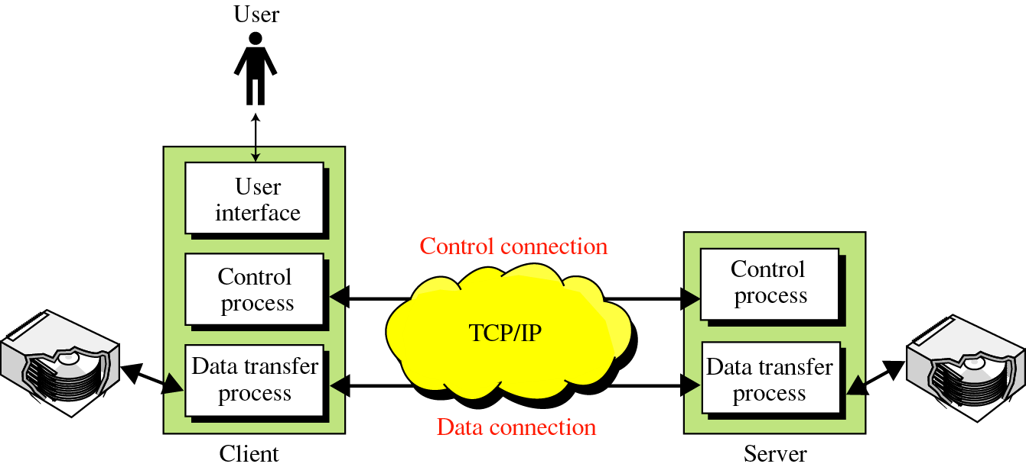
FTP (Cont.)
FTP uses the services of TCP. It needs two TCP connections. The well-known port 21 is used for the control connection and the well-known port 20 for the data connection.
When a user starts an FTP session, the control connection opens. While the control connection is open, the data connection can be opened and closed multiple times if several files are transferred.
Fig. 1 Overview of FTP

Slide 5
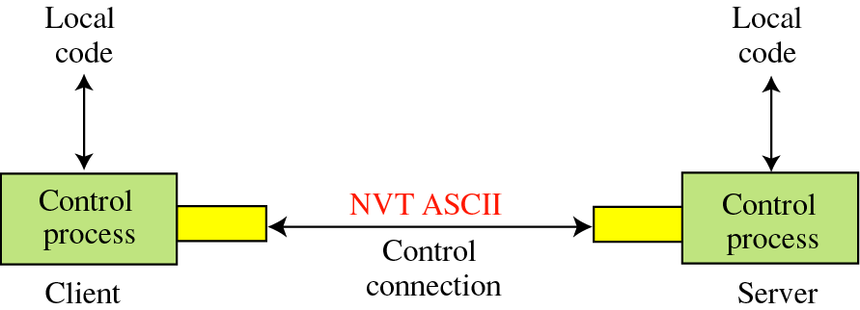
Connections: The control connection
FTP uses the same approach as SMTP to communicate across the control connection. It uses the 7-bit ASCII character set
Communication is achieved through commands and responses.
This simple method is adequate for the control connection because we send one command (or response) at a time.
Fig. 2 Control Connection Communication

Slide 6
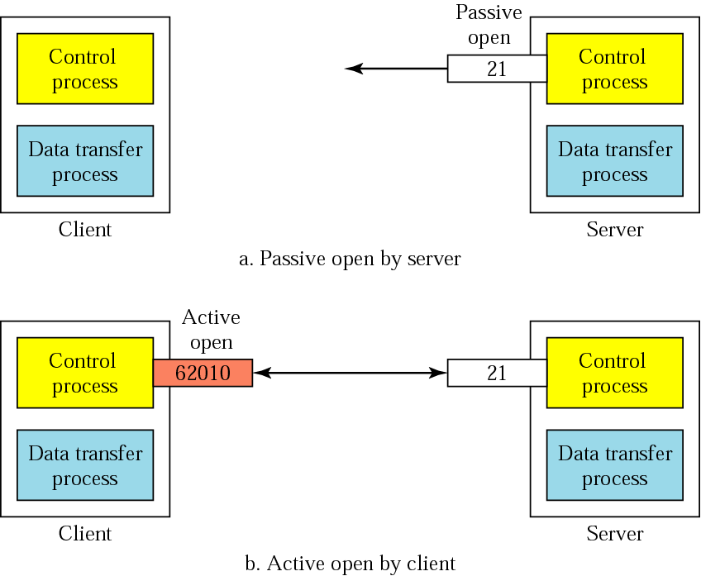
Connections: The control connection
Fig. 3 Connection Control

Slide 7
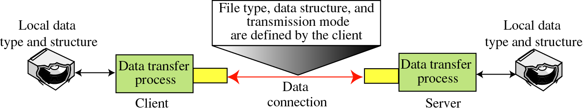
Connections: The Data Connection
File transfer occurs over the data connection under the control of the commands sent over the control connection. File transfer in FTP means one of three things:
A file is to be copied from the server to the client. This is called retrieving aft/e. It is done under the supervision of the RETR command,
A file is to be copied from the client to the server. This is called storing aft/e. It is done under the supervision of the STOR command.
A list of directory or file names is to be sent from the server to the client. This is done under the supervision of the LIST command.
The client must define the type of file to be transferred, the structure of the data, and the transmission mode.
Fig. 4 Data Connection in FTP

Slide 8
Connections: The Data Connection
Uses Server’s well-known port 20
Client issues a passive open on an ephemeral port, say x.
Client uses PORT command to tell the server about the port number x.
Server issues an active open from port 20 to port x.
Server creates a child server/ephemeral port number to serve the client

Slide 9
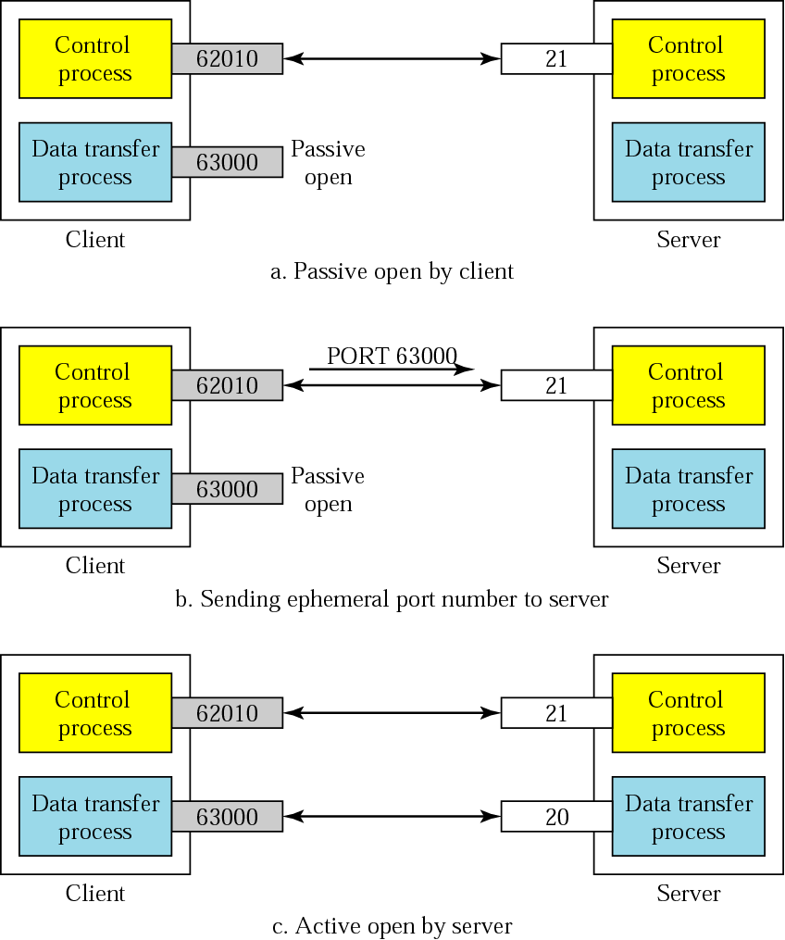
Creating the data connection
Fig. 5 Data Connection Steps

Slide 10
File Type used in Data Connection
ASCII: The ASCII file is the default format for transferring text files. Each character is encoded using 7-bit ASCII. The sender transforms the file from its own representation into ASCII characters, and the receiver transforms the ASCII characters to its own representation.
EBCDIC: If one or both ends of the connection use EBCDIC encoding (the file format used by IBM), the file can be transferred using EBCDIC encoding.
Image: The image file is the default format for transferring binary files. The file is sent as continuous streams of bits without any interpretation or encoding. This is mostly used to transfer binary files such as compiled programs.

Slide 11
Data Structure
FTP can transfer a file across the data connection by using one of the following interpretations about the structure of the data: file structure, record structure, and page structure. These are described as follows:
File Structure: the file is a continuous stream of bytes
Record Structure: the file is divided into records. This can be used only with text files.
Page Structure: the file is divided into pages, with each page having a page number
and a page header. The pages can be stored and accessed randomly or sequentially.

Slide 12
Transmission Mode
FTP can transfer a file across the data connection by using one of the following three transmission modes: stream mode, block mode, and compressed mode.
Stream mode: Data are delivered from FTP to TCP as a continuous stream of bytes. TCP is responsible for chopping data into segments of appropriate size. If the data are simply a stream of bytes (file structure), no end-of-file is needed. End-of-file in this case is the closing of the data connection by the sender.
Block mode: data can be delivered from FTP to TCP in blocks. In this case, each block is preceded by a 3-byte header. The first byte is called the block descriptor; the next 2 bytes define the size of the block in bytes.
Compressed mode: If the file is big, the data can be compressed. Here, consecutive appearances of a data unit are replaced by one occurrence and the number of repetitions. In a text file, this is usually spaces (blanks). In a binary file, null characters are usually compressed.

Slide 13
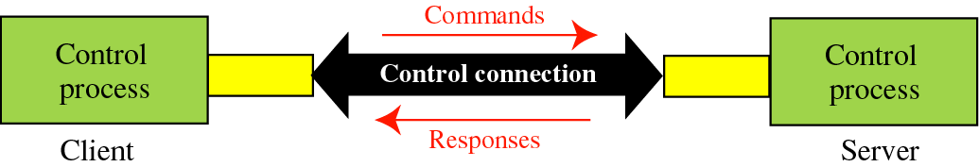
Command processing
Access Commands
File Management
Data Formatting
Port defining
File transfer
Miscellaneous
Fig. 6 Command processing

Slide 14
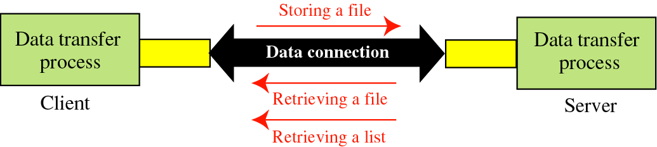
File transfer
Fig. 7 File Transfer Process

Slide 15
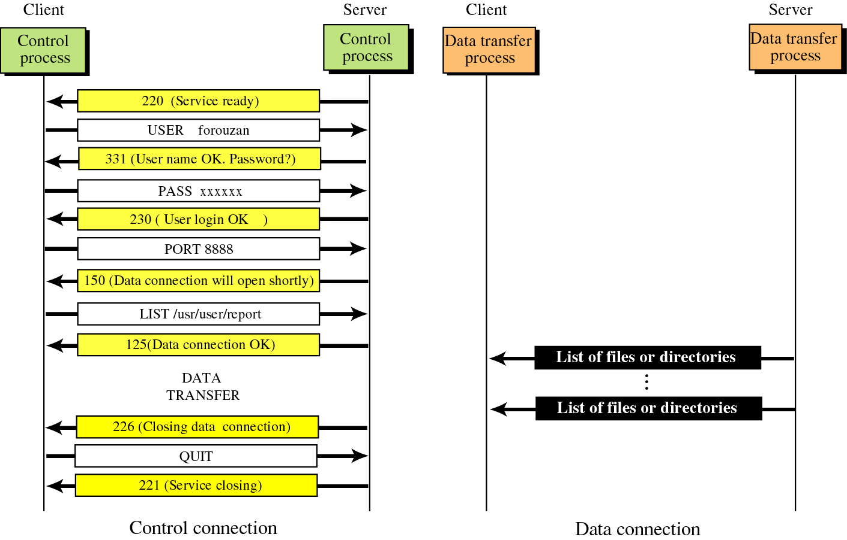
Example
Fig. 8 Example of data transfer and control characters

Slide 16
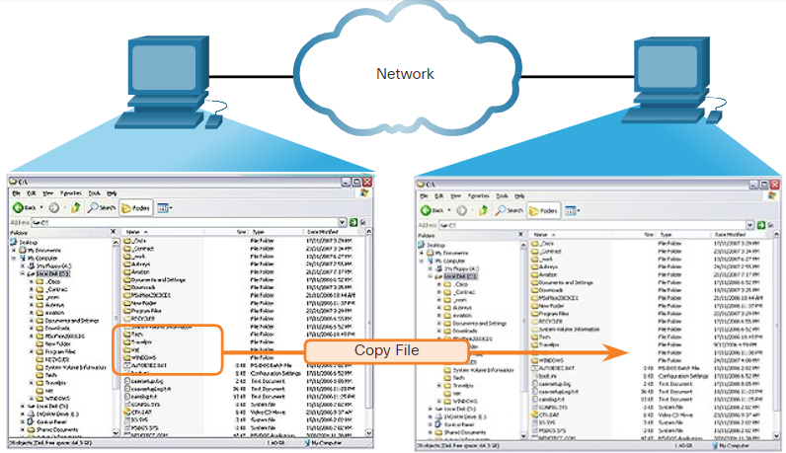
Server Message Block
The Server Message Block (SMB) is a client/server file sharing protocol that describes the structure of shared network resources, such as directories, files, printers, and serial ports. It is a request-response protocol. All SMB messages share a common format.
The three functions of SMB messages:
Start, authenticate, and terminate sessions.
Control file and printer access.
Allow an application to send or receive messages to or from another device.
Fig. 9 Copying File using SMB Protocol

Slide 17
WWW
WORLD WIDE WEB

Slide 18
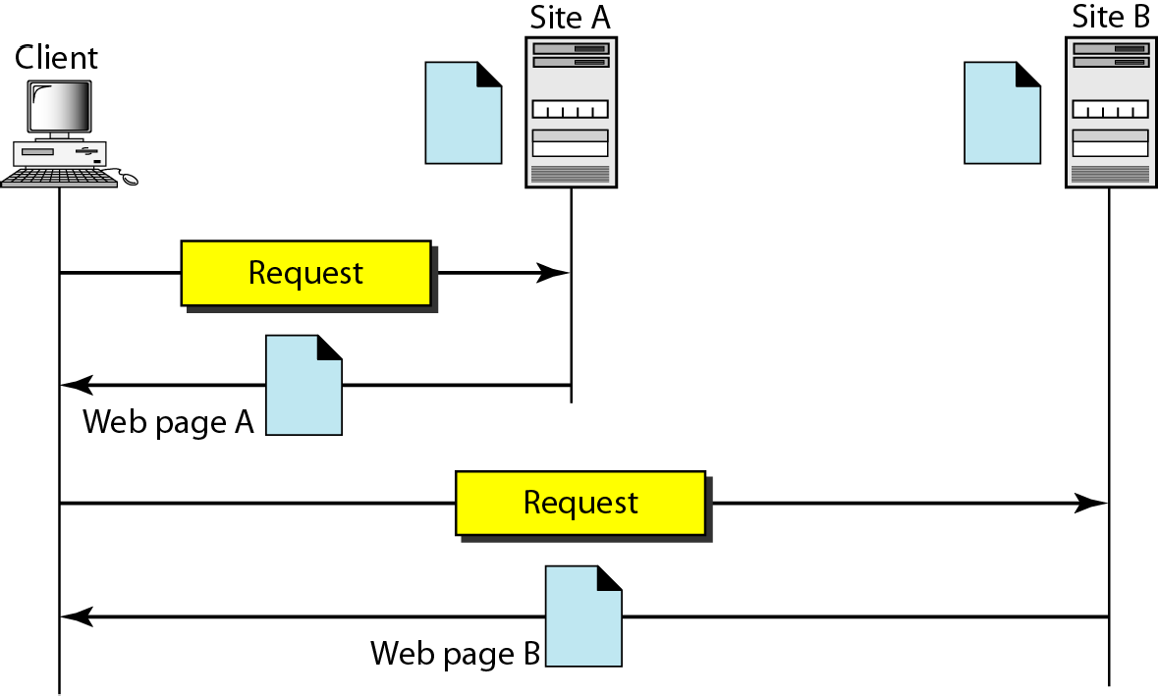
Introduction and Architecture of WWW
The WWW today is a distributed client/server service, in which a client using a browser can access a service using a server. However, the service provided is distributed over many locations called sites.
Fig. 10 Communication Model of WWW

Slide 19
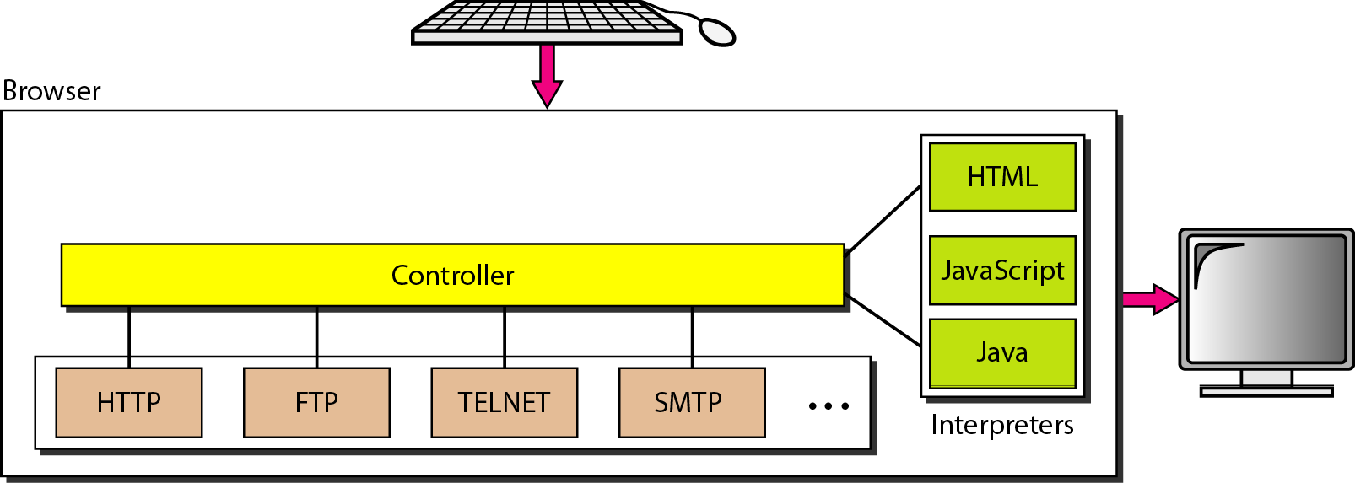
Browser in WWW
Fig. 11 Browser actions in WWW

Slide 20
URL
A client that wants to access a Web page needs the address. To facilitate the access of documents distributed throughout the world, HTTP uses locators.
The uniform resource locator (URL) is a standard for specifying any kind of information on the Internet.
The URL defines four things: protocol, host computer, port, and path
Fig. 12 Structure of URL

Slide 21
Web Documents
The documents in the WWW can be grouped into three broad categories: static,, dynamic, and active. The category is based on the time at which the contents of the document are determined.
Static Documents: Static documents are fixed-content documents that are created and stored in a server. The client can get only a copy of the document. That is, the contents of the file are determined when the file is created, not when it is used.
Dynamic Documents: A dynamic document is created by a Web server whenever a browser requests the document. When a request arrives, the Web server runs an application program or a script that creates the dynamic document. The server returns the output of the program or script as a response to the browser that requested the document

Slide 22
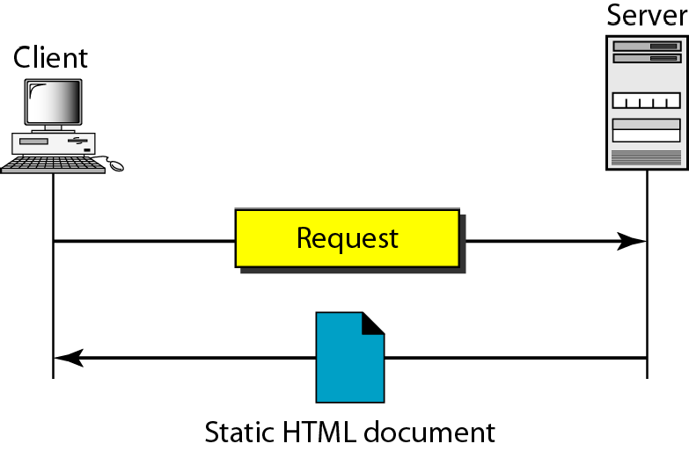
Static Document
Fig. 13 Static Document in WWW

Slide 23
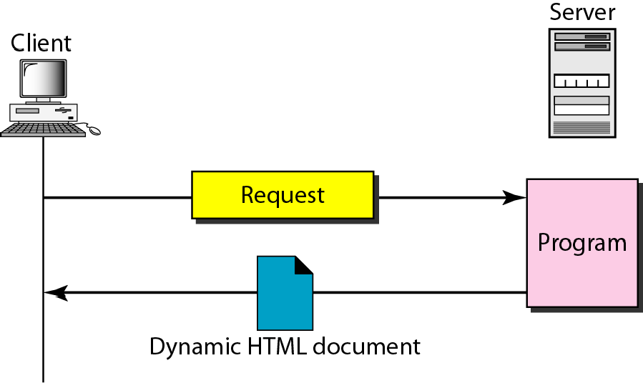
Dynamic Document Using CGI
Fig. 14 Dynamic Document in WWW

Slide 24
HTTP
HYPERTEXT TRANSFER PROTOCOL

Slide 25
HYPERTEXT TRANSFER PROTOCOL
The Hypertext Transfer Protocol (HTTP) is a protocol used mainly to access data on the World Wide Web.
HTTP functions as a combination of FTP and SMTP.
HTTP uses the services of TCP on well- known port 80.
However, it is much simpler than FTP because it uses only one TCP connection. There is no separate control connection; only data are transferred between the client and the server.
The HTTP messages are not destined to be read by humans; they are read and interpreted by the HTTP server and HTTP client (browser).
The commands from the client to the server are embedded in a request message. The contents of the requested file or other information are embedded in a response message.

Slide 26
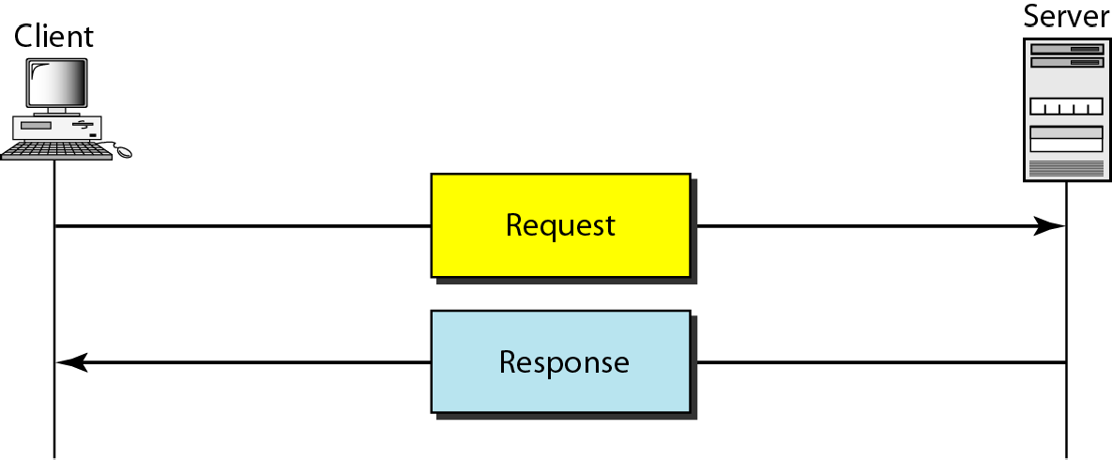
HTTP Transaction
Although HTTP uses the services of TCP, HTTP itself is a stateless protocol. The client initializes the transaction by sending a request message. The server replies by sending a response.
Fig. 15 HTTP Transaction model

Slide 27
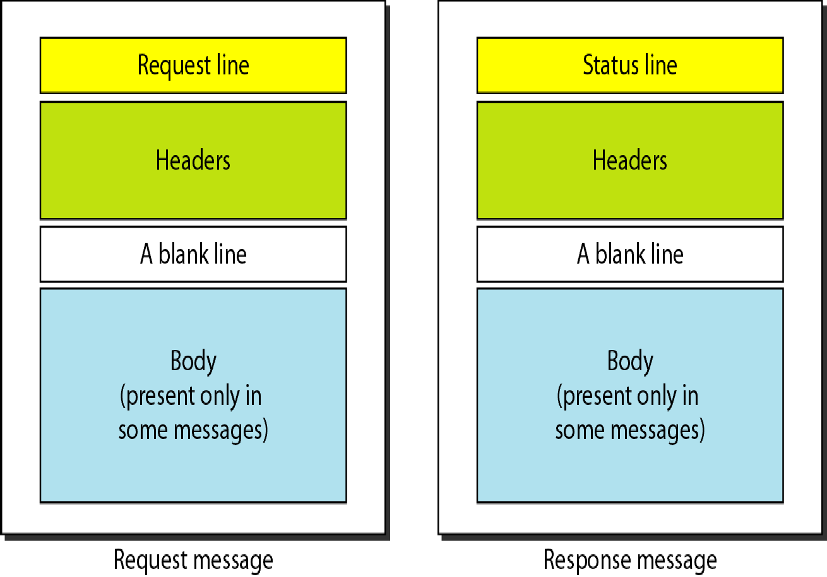
Request and Response Messages
Fig. 16 Message Formats

Slide 28
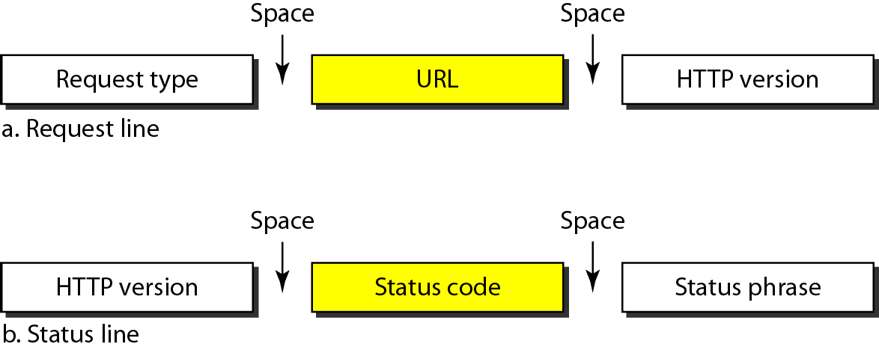
Request and Status Lines
The first line in a request message is called a request line; the first line in the response message is called the status line.
Fig. 17 Lines in HTTP

Slide 29
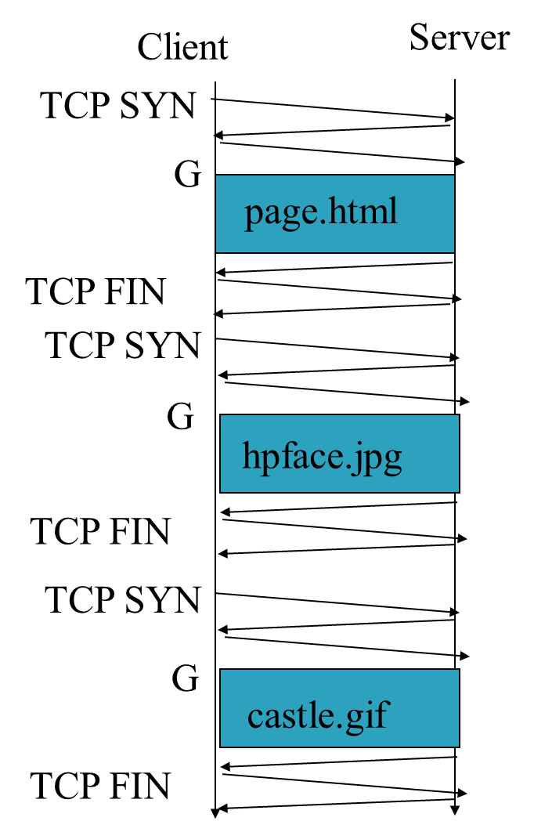
Non-Persistent HTTP
The “classic” approach in HTTP/1.0 is to use one HTTP request per TCP connection, serially.
In a nonpersistent connection, one TCP connection is made for each request/response.
The following lists the steps in this strategy:
1. The client opens a TCP connection and sends a request.
2. The server sends the response and closes the connection.
3. The client reads the data until it encounters an end-of-file marker; it then closes the connection.
“For N different pictures in different files, the connection must be opened and closed N times.”
Fig. 18 Non Persistent HTTP Message exchange

Slide 30
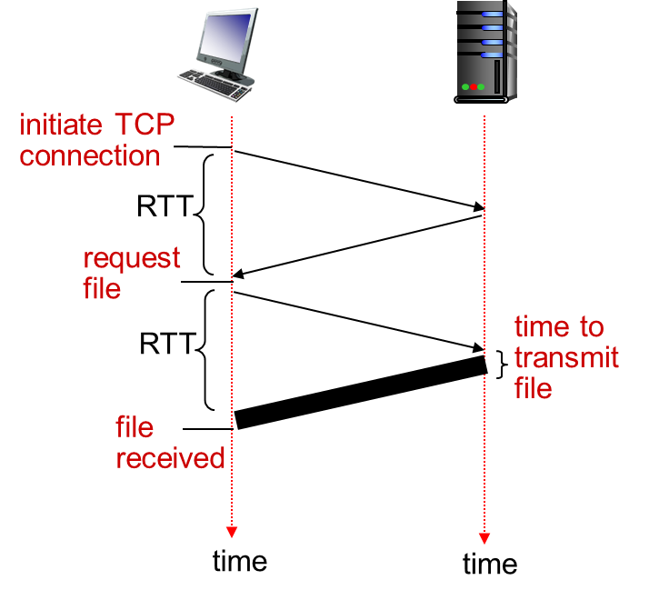
Non-persistent HTTP: response time
RTT: time for a packet to travel from client to server and back
HTTP response time:
one RTT to initiate TCP connection
one RTT for HTTP request and first few bytes of HTTP response to return
This assumes HTTP GET piggy backed on the ACK
file transmission time
non-persistent HTTP response time =
2RTT+ file transmission time
Fig. 19 Round trip time

Slide 31
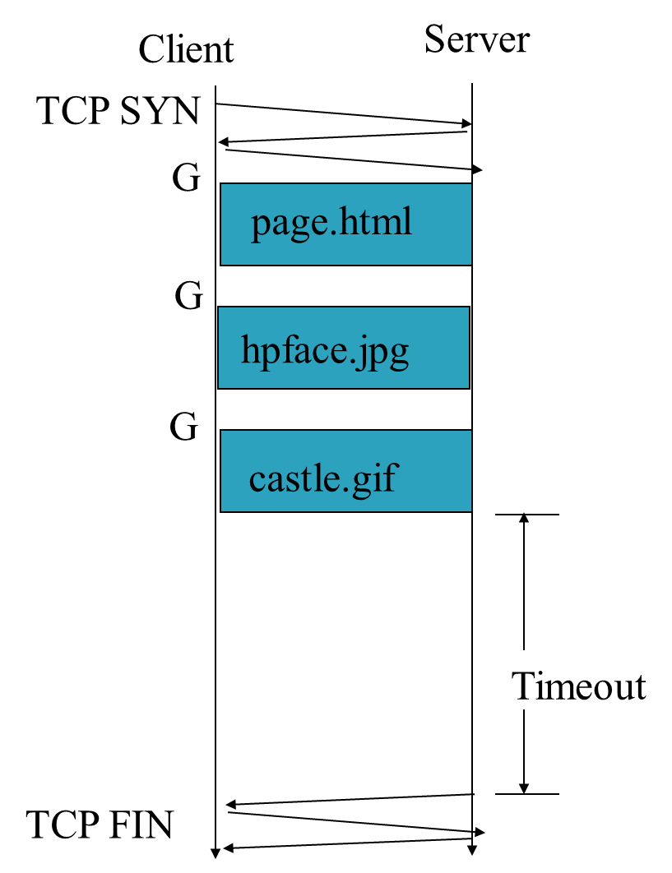
Persistent HTTP
The server leaves the connection open for more requests after sending a response. The server can close the connection at the request of a client or if a time-out has been reached. The sender usually sends the length of the data with each response.
The “persistent HTTP” approach can re-use the same TCP connection for multiple HTTP transfers, one after another, serially. Amortizes TCP overhead, but maintains TCP state longer at server.
Fig. 20 Persistent HTTP

Slide 32
Persistent vs. Non-Persistent HTTP
non-persistent HTTP issues:
requires 2 RTTs per object
OS overhead for each TCP connection
browsers often open parallel TCP connections to fetch referenced objects
persistent HTTP:
server leaves connection open after sending response
subsequent HTTP messages between same client/server sent over open connection
client sends requests as soon as it encounters a referenced object
as little as one RTT for all the referenced objects

Slide 33
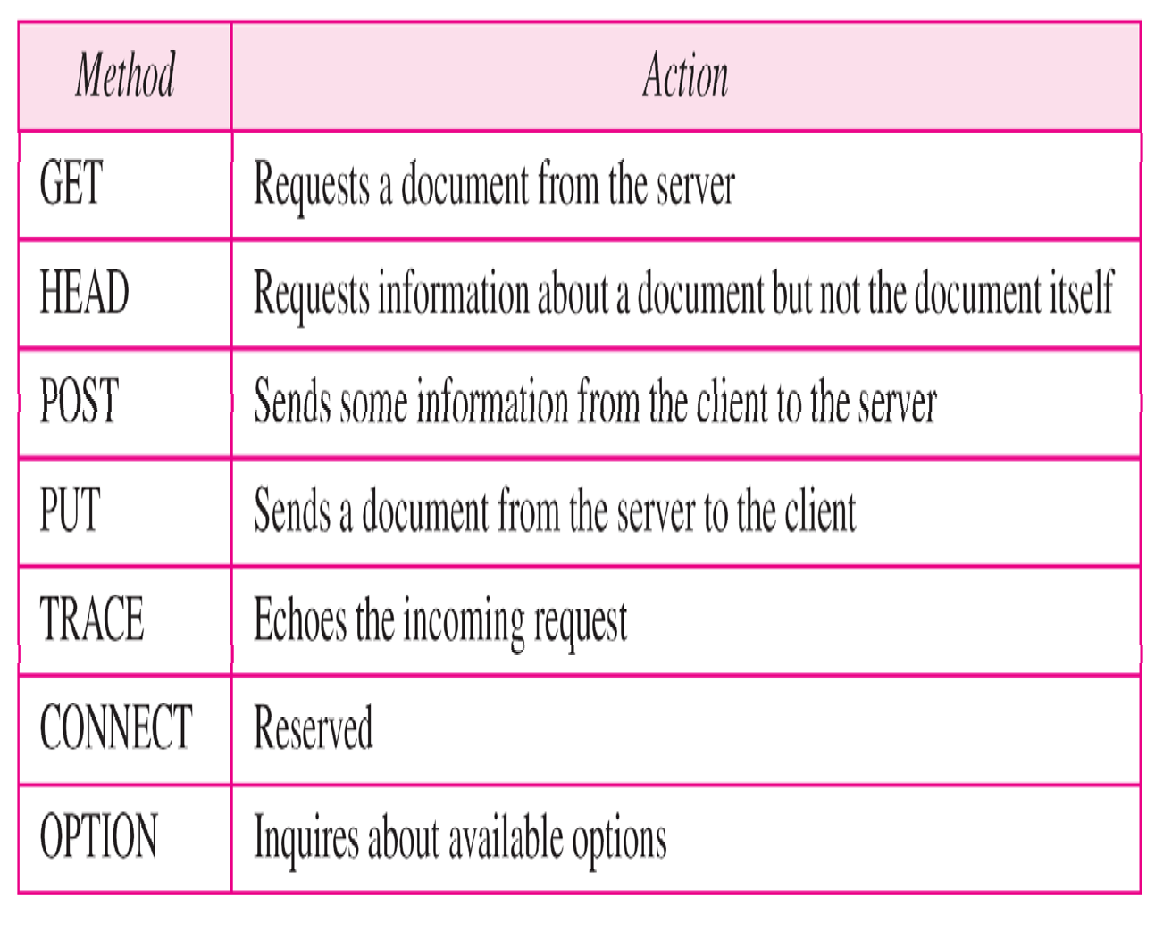
Methods

Slide 34
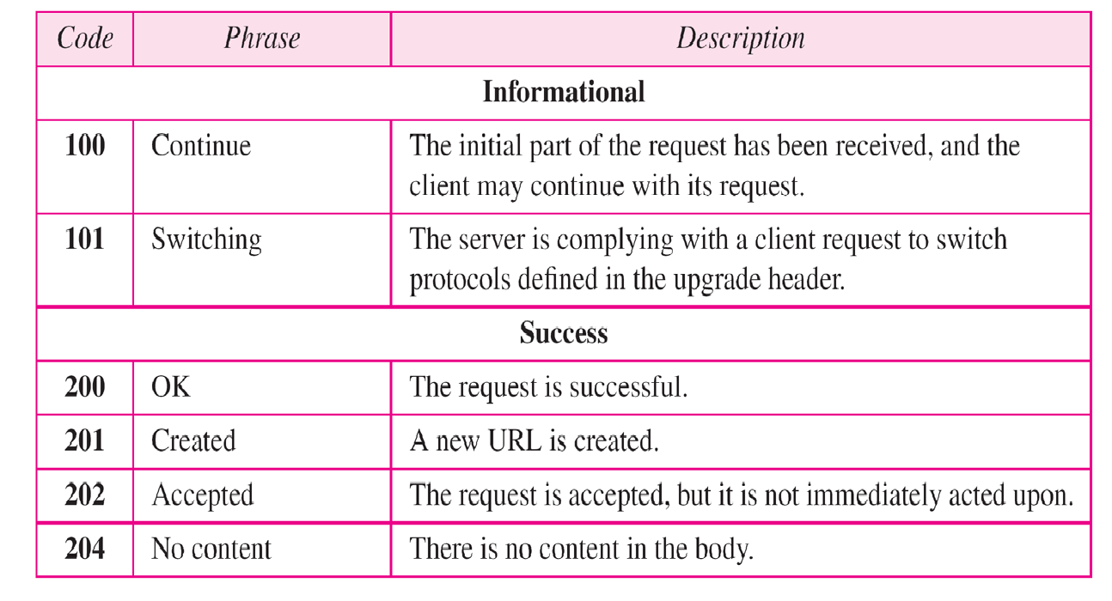
Status codes

Slide 35
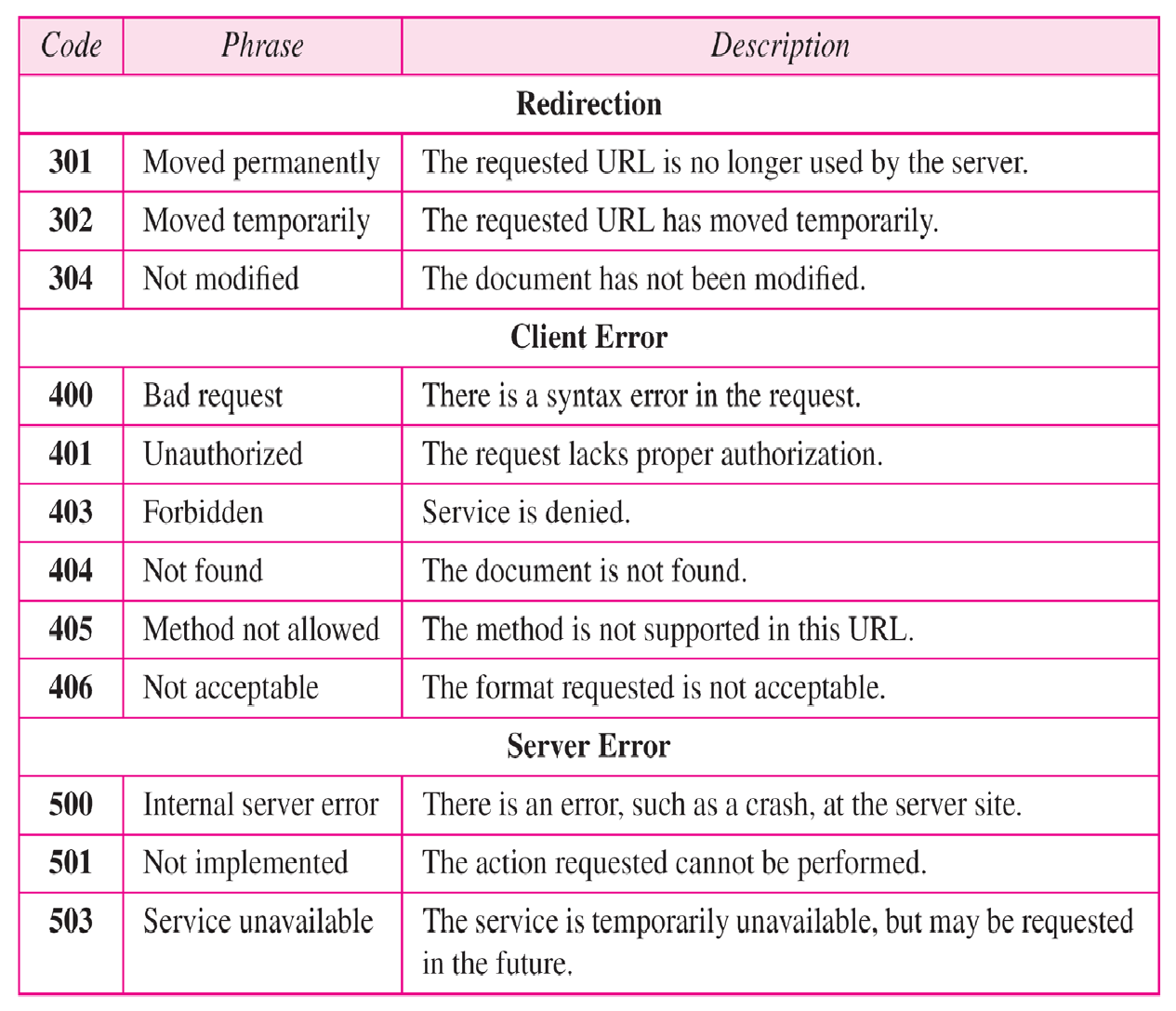
Status codes

Slide 36
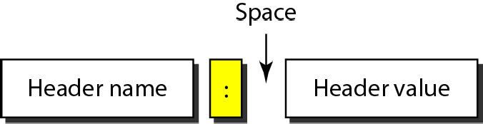
Header Format
Fig. 21 Header Format of HTTP

Slide 37
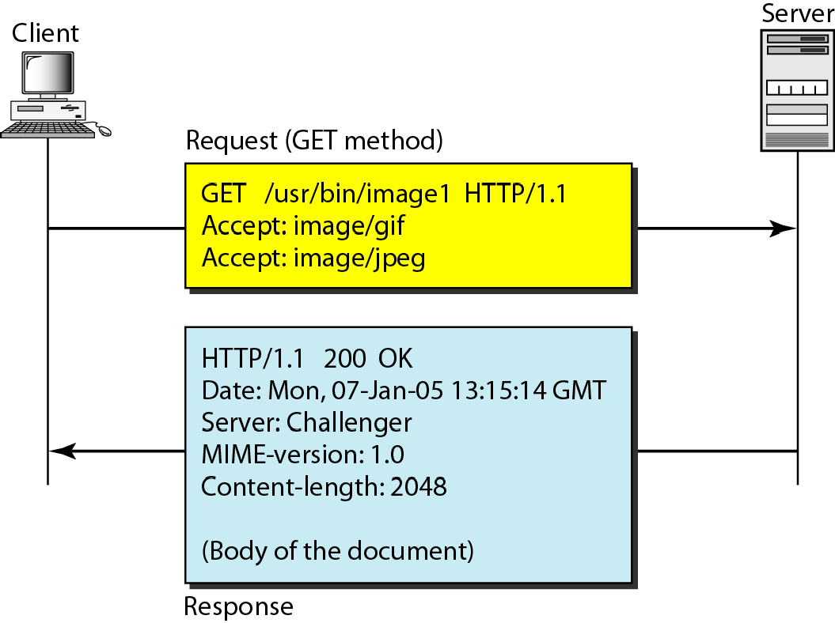
Example
Fig. 22 Message exchange in HTTP (Example)

Slide 38
Example
This example retrieves a document. We use the GET method to retrieve an image with the path /usr/bin/image1. The request line shows the method (GET), the URL, and the HTTP version (1.1). The header has two lines that show that the client can accept images in the GIF or JPEG format. The request does not have a body. The response message contains the status line and four lines of header. The header lines define the date, server, MIME version, and length of the document. The body of the document follows the header.

Slide 39
Practice Questions
This message type is used when uploading data files to a web server.
GET
POST
PUT
This protocol is used by a client to send email to a mail server.
POP
SMTP
IMAP
HTTP
HTTP is a secure protocol? True or False
True
False

Slide 40
References
Books:
Data Communications and Networking’ by Forouzan, 5th Edition, 2013.
Computer Networks’ By Andrew S. Tanenbaum 5th Edition, Pearson Education,2013.
Data and Computer Communications’ by William Stallings, 8th Edition, Pearson,2007.
E-Resources:
CISCO Networking Academy
https://library.chitkara.edu.in/subscribed-books.php

